Slide 1

VCA Project Analysis
December 1, 2015

Slide 2
Agenda
1 Background / Objectives
2 Segmentation
3 Elasticity Modelling
4 Logistic Regression
5 Bundling

Slide 3


Background / Objective
Background
VCA, the leader in animal hospitals with over 600 hospitals in the United States, provides premium pet care services from general, surgical to specialized care. VCA would like to understand key factors that drive revenue.
Objective
The primary objective of this study is to find ‘What drives net revenue for VCA?’
Data
2 years of transactions data including amount spent, number of units, time between purchases etc. Also results from a satisfaction survey. A dataset including clinic statistics, marketing spend, number of competitors, various demographics.

Slide 4
Overall Revenue Growth fell YOY by 3.6%
Top 8 Services Revenue Comparison (in $ MN)
 | Prescription | Laboratory | Surgery | Examination | Hospitalized | Parasite | Vaccination | Food
% Revenue Change YOY | (3%) | (4%) | (12%) | (6%) | (14%) | 4% | (3%) | 6%

Slide 5
Average Price per Unit increased significantly YOY for all services
Top 8 Services Price Increase
 | Prescription | Laboratory | Surgery | Examination | Hospitalized | Parasite | Vaccination | Food
% Price Increase YOY | 28% | 6% | 62% | 3% | 42% | 15% | 7% | 7%
Price Elasticity | -0.04 | -0.07 | -0.23 | -0.48 | -0.04 | -0.56 | -0.09 | -0.33

Slide 6
Responsiveness to Price Changes Can Be Leveraged to Set Pricing Strategy for the Portfolio
Product/Service | Average Price | Price Elasticity | New Average Price | Old Revenue | New Revenue | Revenue Impact
Prescription | $ 14.9 | -0.04 | $ 16.4 | $ 1,665 | $ 1,824 | $ 160
Laboratory | $ 99.9 | -0.07 | $ 109.8 | $ 342 | $ 373 | $ 32
Surgery | $ 51.4 | -0.23 | $ 56.5 | $ 304 | $ 327 | $ 23
Examination | $ 52.2 | -0.48 | $ 57.5 | $ 177 | $ 185 | $ 8
Hospitalized | $ 25.3 | -0.04 | $ 27.9 | $ 563 | $ 617 | $ 54
Parasite | $ 73.4 | -0.56 | $ 80.8 | $ 227 | $ 236 | $ 9
Vaccination | $ 25.3 | -0.09 | $ 27.8 | $ 101 | $ 110 | $ 9
Food | $ 26.2 | -0.33 | $ 28.8 | $ 313 | $ 333 | $ 20

Slide 7

Which customer segments drive revenue for VCA?

Slide 8
Segmentation
All client level data was merged together. Some variables were rolled up to client level
Following variables were identified for segmentation:
Total Revenue generated
Total Units bought
Average days between visits
Total current patients
Average price paid
Various cluster solutions tried. Optimum number of clusters found: 3

Slide 9
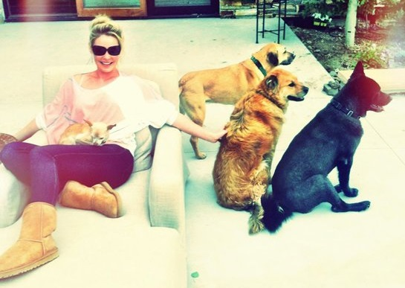
The Katherine Heigls
See you Again Soon: 15 days
More the Merrier: 12 pets!!!
This is where the Money is Honey: generate a large chunk of revenue (46%)
Units: Consume largest chunk of units (45%)
We got the discounts: Pay the lowest average price (~$ 10.0)
Notes:
Pets: 8 dogs, 3 cats, 2 donkeys, 2 pygmy goats, 10 chickens, 9 horses, 2 miniature horses

Slide 10
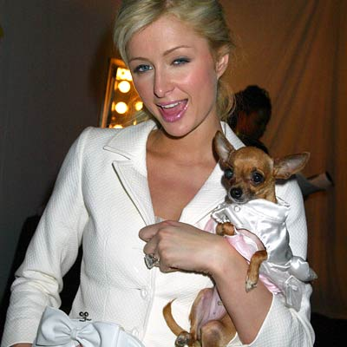
The Paris Hiltons
See you later: 80 days later!!!
One & Only: 1 pet
Revenue: Revenue (21%)
Fit & Fine: Consume smallest chunk of units (14%)
High Maintenance: Pay the highest average price (~$ 17.0)

Slide 11
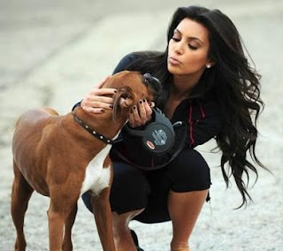
The Kim Kardashians
See you Again: 26 days
Average Number: 3 pets
This is where the Money is Honey: generate a sizeable chunk of revenue (32%)
Units: Consume large chunk of units (41%)
Price: Average price (~$ 12.0)

Slide 12
Segmentation

Slide 13
Segmentation Summary
 | Heigls | Hiltons | Kardashians
% customers | 1% | 88% | 12%
% Revenue | 46% | 21% | 32%
% Units | 45% | 14% | 41%
Average price | $ 10.4 | $ 17.3 | $ 12.8
Average patients | 12 | 1 | 4
Avg Days between visits | 15 | 80 | 26
Overall Satisfaction | 7 | 6 | 6.7
Likely Recommend | 9.3 | 8.7 | 9.1
Share Prescription | 6% | 55% | 40%
Share Laboratory | 5% | 66% | 29%
Share Surgery | 7% | 60% | 33%
Share Examinations | 4% | 71% | 25%
Share Hospitalized | 12% | 44% | 44%
Share Vaccination | 3% | 77% | 20%

Slide 14
Price Elasticities – Rules of Thumb
Magnitude of Elasticity | Rule of Thumb
< -1.71 | Highly Elastic
-1.21 to -1.70 | Elastic
-1.00 to -1.20 | Moderately Elastic
-0.51 to -0.99 | Inelastic
> -0.50 | Highly Inelastic
Sensitivity to Change in Price
Price Elasticity Quantifies The Impact Of Price Change, And Can Be Leveraged To Manage Pricing and Profit Risk Associated with Price Changes

Slide 15
Price Sensitivity: Putting Price Response Into Perspective
Hiltons
-0.87
Kardashians
-0.89
Heigls
-0.80
Highly Elastic
-1.7
-1.2
-1.0
-0.5
Highly Inelastic
Price Elastic/Sensitive
Elastic
Moderately Elastic
Inelastic
Price Inelastic/Insensitive
Imported
Beer
-2.2
Premium
Ice Cream Bars
-1.30
Chocolate/Candy/Gum
-1.39
Specialty
Sports
Drink
-1.18
Premium Chocolate
-1.20
Premium Skin Care
-0.75
Super Premium Alcohol
-0.40

Slide 16
Revenue impact of a 10% price increase is highest for Heigls
Simulation: VCA Revenue Impact from Price Changes
Scenario | Revenue Impact
Heigls (10% Price Increase) | $ 228.7
Hiltons (10% Price Increase) | $ 14.4
Kardashians (10% Price Increase) | $ 19.7

Slide 17
What are Price Thresholds?
Typically, price elasticity (base and promoted) is depicted as a smooth constant relationship between price and volume
Constant Price Impact
As price increases, sales decline at a constant rate
Sales
Price
In reality, the curve exhibits threshold points at which the change in sales is much more pronounced
Thresholds work both ways:
Sales decline at a faster rate when threshold is passed by increasing price
Sales increase at a faster rate when threshold is passed by decreasing price
Non-Constant Price Impact
As price passes threshold, sales decline at an accelerated rate
Sales
Price

Slide 18
Impacts from pricing should take into account $22 threshold
Vaccination – $22 Price Threshold
Significant Price Point Threshold
Revenue impact without threshold
Revenue impact with threshold
Service | Average Price per Unit | Revenue Impact without Crossing Threshold | Revenue Impact with Crossing Threshold | Net Revenue Impact
Vaccination | $ 23.5 | $ (12.98) | $ (1.86) | $ (14.85)

Slide 19
Heigls: Recommendations
Price inelastic. Do not react to small changes in price.
Increase price gradually, but beyond 13% diminishing returns start kicking in
A 10% price increase will lead to additional revenue of $ 229 per customer on average
Do not increase marketing spend as marketing spend is insignificant. May lead to revenue loss
Value tenured vets
From survey information, important to make them feel cared and at home. They value this a lot and it could lead to more frequent trips leading to an additional revenue generation of upto $ 500 per person on average.

Slide 20
Hiltons : Recommendations
Price inelastic. Do not react to small changes in price.
Can increase price but beyond 9% diminishing returns start kicking in
A 10% price increase will lead to additional revenue generation of $ 14 on average per person
Priced high because non regular
Do not increase marketing spend on this segment as marketing spend is insignificant. Will lead to revenue loss
Visit mostly when their pets are sick. Can capitalize on this by targeting this segment for pet sickness related services.
This could generate additional revenue of $ 40 per person on average

Slide 21
Kardashians: Recommendations
Can increase price but not beyond 5 %. Most price sensitive segment
A 5% increase in price will be most impactful with an increase of revenue generation by $ 35 per person on average
Can increase marketing spend but returns are minimal
Survey variables significance indicates high sensitivity to hospital atmosphere and feeling of belongingness
Improvement in these factors could lead to higher satisfaction which could lead to more services being taken leading to an additional revenue generation of approx. $ 250 per person
Efforts should be made to induce the customer to make an additional trip per month

Slide 22
Insights
An ~10% increase in variables positively impacting net revenue across segments will lead to a 10% increase in net revenue (from $ 35 MN to $ 39 MN)
Heigls contribute most to total revenue for VCA. Targeting this segment for services most used by them will drive net revenue
Customers belonging to Heigls are more satisfied overall and are more likely to recommend VCA to other customers who might be customers of competitors

Slide 23

Which customers are likely to purchase which product/service?

Slide 24
Logistic Regression: Laboratory
A customer being a dog owner and coming from a rural area increases the probability of purchasing a Laboratory service by 119% and 44% respectively.
This information can be used to promote specific services to targeted customers to drive revenue growth
Market Basket Analysis can be used to determine the types of services that are taken together. That information can be used to bundle services and drive additional revenue growth

Slide 25
Logistic Regression: Surgery & Prescription

Slide 26
Logistic Regression: Bundling

Slide 27
Thank You!

